Slide 1
Locking

Slide 2

About the Author
Created By: | Sucharita Das (241163) & Rajalaxmi (301159)
Credential Information: | 8+ years of SQL Server developer/architect experience
Version and Date: | SS2008/0611/1.0
Cognizant Certified Official Curriculum

Slide 3









Icons Used
Hands on Exercise
Questions
Tools
Coding Standards
Test Your Understanding
Reference
A Welcome Break
Contacts
Demonstration

Slide 4
Locking: Overview
At the end of this session you will come to know:
Locks and their types, modes
Lock compatibility
Lock Escalation
Dynamic locking
Identifying Locks
Lock configuration
Locking Hints

Slide 5
Locking: Objectives
Objective:
After completing this chapter you will be able to:
Describe the types of locking.
Describe the various modes of locking.
How to identify locking.

Slide 6
Locks
A mechanism to avoid the existence of inconsistent data
Prevents multiple users or applications from making simultaneous changes to data

Slide 7
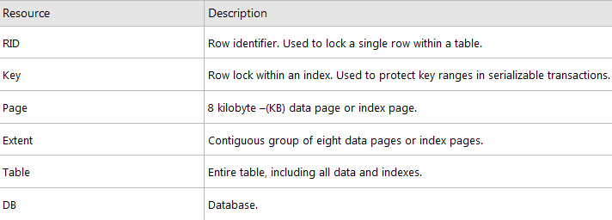
Lock Types

Slide 8
Key-Range Locks
A key-range lock works by covering the index rows and the ranges between those index rows rather than locking the entire base table rows.
Because any attempt to insert, update, or delete any row within the range by a second transaction requires a modification to the index, the second transaction is blocked until the first transaction completes because key-range locks cover the index entries.

Slide 9
Key-Range Locks(1)
Includes two Component:
Range - the lock mode protecting the range between two consecutive index entries.
Row - the lock mode protecting the index entry.
Mode - the combined lock mode used.
Key-range lock modes consist of two parts. The first represents lock used on the index range (RangeT) and the second represents the lock used on a specific key (K). The two parts are connected with an underscore (_), such as RangeT_K.

Slide 10
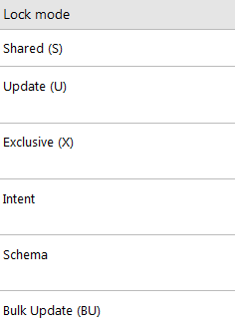
Different Lock Modes

Slide 11
Shared Locks
Used for operations that do not change or update data (read-only operations), such as a SELECT statement.
Released as soon as data are read (except for REPEATABLE READ)

Slide 12
Exclusive Locks
Used for data-modification operations, such as INSERT, UPDATE, or DELETE. It ensures that multiple updates cannot be made to the same resource at the same time.

Slide 13
Update Locks
Update locks (U) are acquired just prior to modifying the data.
If a transaction modifies a row, then the update lock is escalated to an exclusive lock; otherwise, it is converted to a shared lock.
Used on resources that can be updated. It prevents a common form of deadlock that occurs when multiple sessions are reading, locking, and potentially updating resources later.

Slide 14
Diff. between Exclusive and Update locks
Update Lock is kind of Exclusive Lock except it can be placed on the row which already have Shared Lock on it.
Update Lock reads the data of row which has Shared Lock, as soon as Update Lock is ready to change the data it converts itself to Exclusive Lock.

Slide 15
Intent locks
The intent lock shows the future intention of SQL Server's lock manager to acquire locks on a specific unit of data for a particular transaction.
SQL Server uses intent locks to queue exclusive locks, thereby ensuring that these locks will be placed on the data elements in the order the transactions were initiated.
You can queue your transactions to acquire the locks later.

Slide 16
Intent Shared Locks(IS)
IS locks indicate that the transaction will read some (but not all) resources in the table or page by placing shared locks.

Slide 17
Intent Exclusive Locks(IX)
IX locks indicate that the transaction will modify some (but not all) resources in the table or page by placing exclusive locks.

Slide 18
Shared with Intent Exclusive(SIX)
SIX locks indicate that the transaction will read all resources, and modify some(but not all) of them.
This will be accomplished by placing the shared locks on the resources read and exclusive locks on the rows modified.

Slide 19
SIX
Only one SIX lock is allowed per resource at one time; therefore, SIX locks prevent other connections from modifying any data in the resource (page or table), although they do allow reading the data in the same resource

Slide 20
Schema Locks
Schema modification locks (Sch-M) are acquired when data definition language statements, such as CREATE TABLE, CREATE INDEX, ALTER TABLE, and so on are being executed. It blocks the transactional locks.
Schema stability locks (Sch-S) are acquired when compiling queries. Schema stability (Sch-S) locks do not block any transactional locks.

Slide 21
Bulk Update locks
Bulk update locks (BU) are used when performing a bulk-copy of data into a table with TABLOCK hint.
These locks improve performance while bulk copying data into a table; however, they reduce concurrency by effectively disabling any other connections to read or modify data in the table.

Slide 22
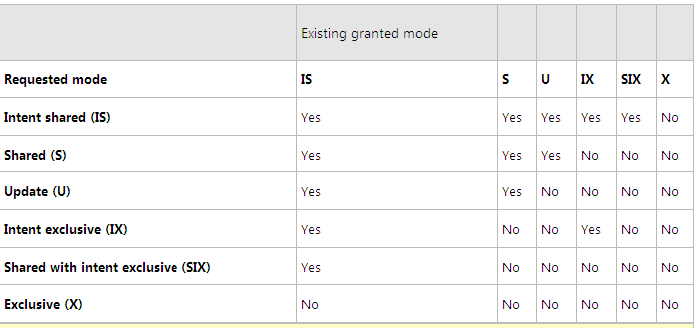
Lock compatibility

Slide 23
Lock escalation
Lock escalation is the process of converting many fine-grain locks into fewer coarse-grain locks, reducing system overhead.
SQL Server automatically escalates row locks and page locks into table locks when a transaction exceeds its escalation threshold.
When Row lock is acquired – SQL Server sets intent lock on page or key – when threshold exceeded- row lock transforms to higher lock – to overcome system overhead.

Slide 24
Dynamic locking
Although row level locks increase concurrency, it is at the cost of system overhead. Table or page locks lower overhead, but at the expense of lowering concurrency.
SQL Server automatically determines what locks are most appropriate when the query is executed, based on the characteristics of the schema and query.

Slide 25
Identifying locks
sp_lock :
- information about locks.
Syntax
- sp_lock [[@spid1 =] 'spid1'] [,[@spid2 =] 'spid2']
sp_who :
- to obtain process information about the lock.
Sp_who2 :
- current blocked and blocking process

Slide 26
DMV to identify locks
Using system table
select cmd,* from sys.sysprocesses where blocked > 0
Using DMV - sys.dm_tran_locks
Example script

Slide 27
Configure lock
In Object Explorer, right-click a server and select Properties.
Click the Advanced node.
Under Parallelism, type the desired value for the locks option.
Use the locks option to set the maximum number of available locks.
The default setting is 0, which allows SQL Server to allocate and deallocate locks dynamically based on changing system requirements.
Max number of locks/session : 262143

Slide 28
Locking Hints
ROWLOCK Use row-level locks when reading or modifying data.
PAGLOCK Use page-level locks when reading or modifying data.
TABLOCK Use a table lock when reading or modifying data.
DBLOCK Use a database lock when reading or modifying data.

Slide 29
Locking Hints (1)
UPDLOCK UPDLOCK reads data without blocking other readers, and update it later with the assurance that the data has not changed since last read.
XLOCK Use exclusive locks instead of shared locks while reading a table, and use hold locks until the end of the statement or transaction.

Slide 30
Locking Hints (2)
HOLDLOCK Use a hold lock to hold a lock until completion of the transaction, instead of releasing the lock as soon as the required table, row, or data page is no longer required.
NOLOCK This does not lock any object. This is the default for SELECT operations. It does not apply to INSERT, UPDATE, and DELETE statements.

Slide 31
Test Your Understanding
Explain the various types of locking.
Mention the modes of locking.
What is lock escalation?
List the table hints available?

Slide 32
Locking: Summary
The different locks and their usage
How to identify and configure them for better efficiency

Slide 33
Locking: Source
http://msdn.microsoft.com/en-us/library/aa213039(v=sql.80).aspx
http://www.informit.com/articles/article.aspx?p=26890&seqNum=4

Slide 34

You have successfully completed SQL Server Locking concepts

